Slide 1
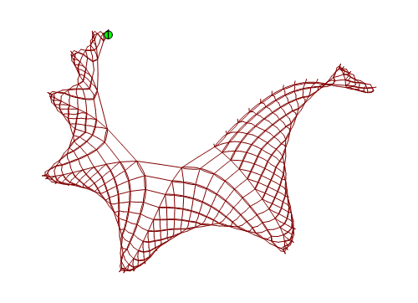
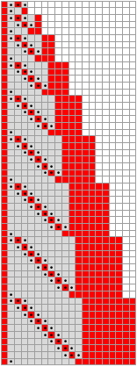
SESSIE NetWorks
Causal networks of SSSs
(Sequential Substitution Systems)
Pattern Hunting!

Slide 2
Simple Rules → Complex Behavior
Strategy:
Take all possible sets of simple rules
Apply them repeatedly
Look for complex behavior
Features similar to the real universe?

Slide 3
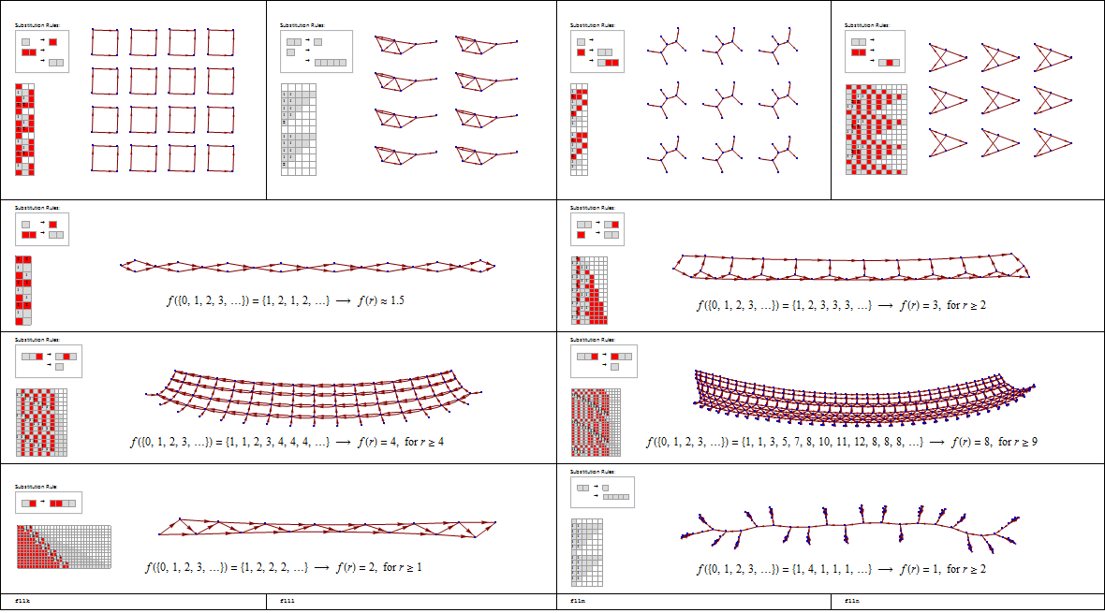
Rule Sets → Sessies → Networks

Slide 4
Different Rule Sets → Different Sessies → Different Networks

Slide 5
Different Rule Sets → Different Sessies → Different Networks

Slide 6
Different Rule Sets → Different Sessies → Different Networks

Slide 7
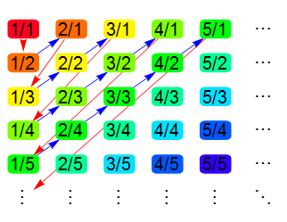
List of all possible rule sets
Inspired by Cantor’s enumeration of all fractions

Slide 8
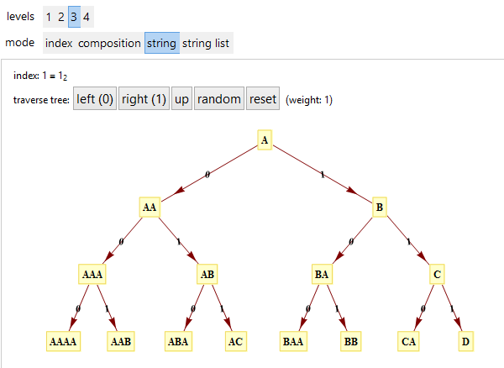
List of all possible rule sets
Inspired by Cantor’s enumeration of all fractions
Universal String Enumeration aka Tree of All Strings
http://demonstrations.wolfram.com/TreeOfStrings/

Slide 9
List of all possible rule sets
Inspired by Cantor’s enumeration of all fractions
Universal String Enumeration aka Tree of All Strings
http://demonstrations.wolfram.com/TreeOfStrings/
Enumeration of all SSS rule sets
http://www.mathematica-journal.com/2011/05/indexing-strings-and-rulesets/
Improved Generalized SS Enumeration
To be published: KC & Christen Case (SAU 2015)

Slide 10
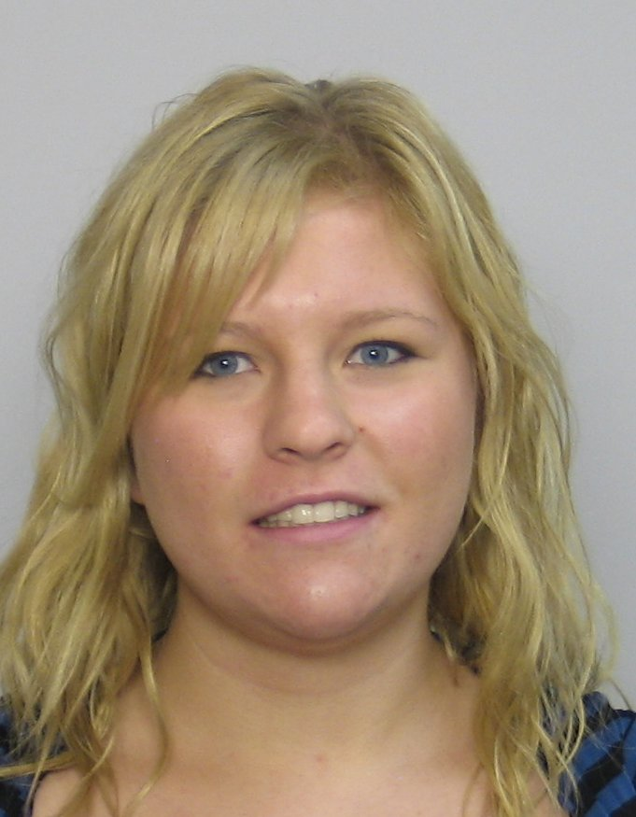
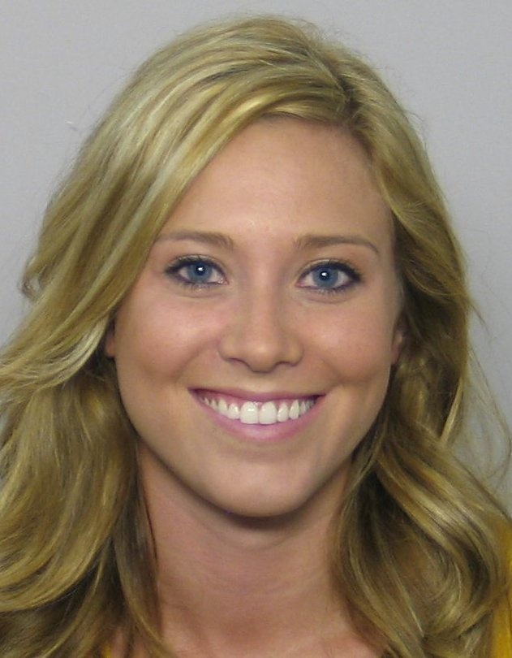
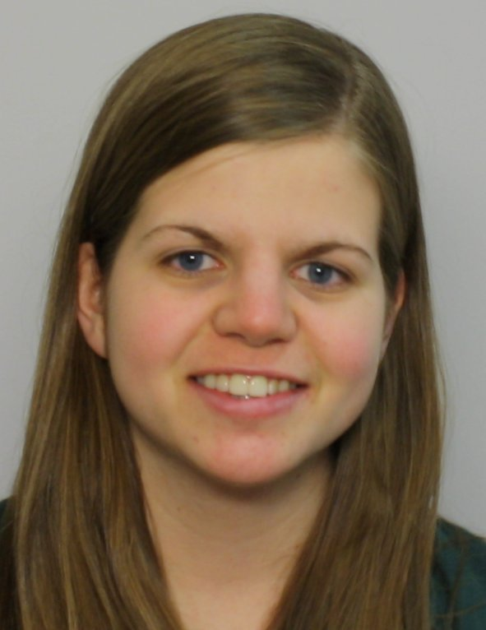
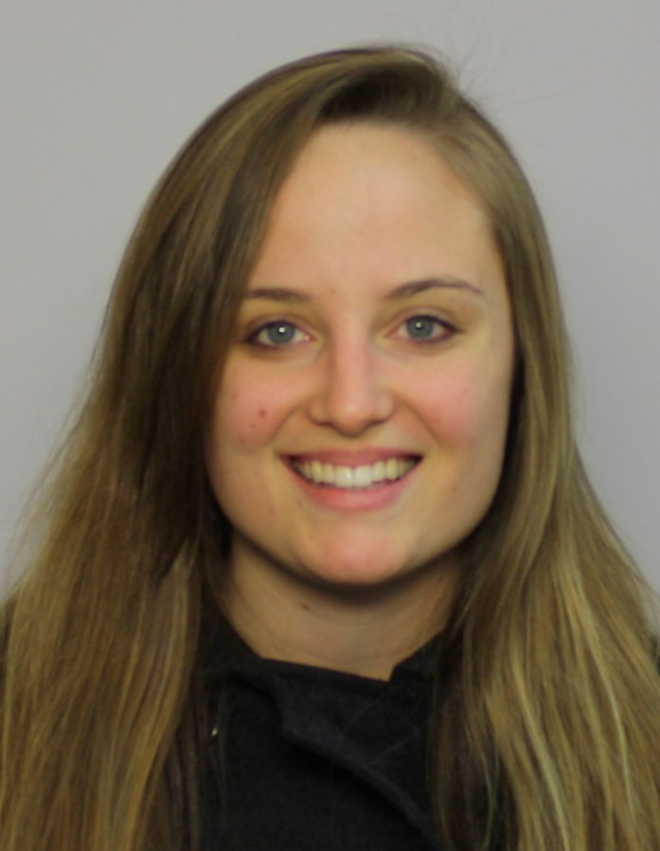

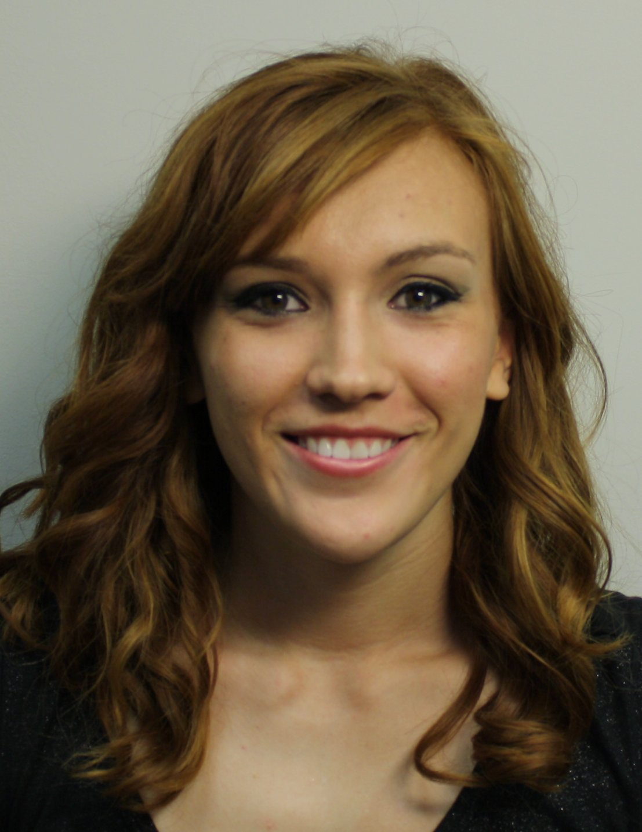

Human inspection of networks
Breanna Bowden-Green (ENGR, W11)
Kelsey Dobbs (ENGR, W10)
Mathematical treatment of network properties
Amy Beard (MATH, W12)
Improved enumeration & acceleration
Christen Case (CHEM/MATH, F14)
Programmatic identification of dimension
Lucas Valenca, Camille Morrow, Drew Blake, ?
Research stages

Slide 11
Network dimension
0: Does not extend in any direction
No network or dies out?
Infinitely repeating separate clumps, increasingly complex

Slide 12
Network dimension
0: Does not extend in any direction
1: Extends in only one direction
May have more dimensions on small scale
Like the hidden dimensions of String Theory

Slide 13
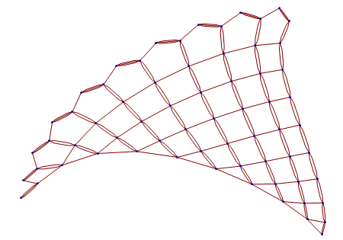
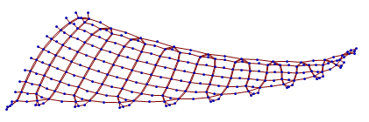
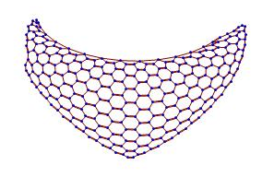
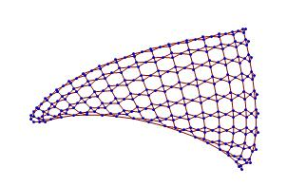
Network dimension
2: Extends (forever) in two directions

Slide 14
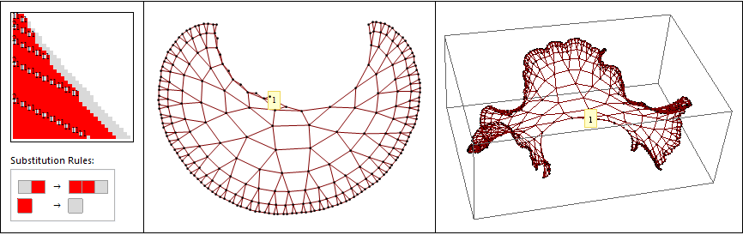
Network dimension
3: Three-dimensional growth?
Maybe not, getting infinitely dense → Exponential Growth

Slide 15
Network dimension
Devise mathematical ways to recognize dimension
Run the infinite loop, only show new cases
Exponential
3-dimensional
4-, 5-, …, dimensional
Fractional dimensional? (Fractals!)
Other?

Slide 16
SESSIE NetWorks
Now go to Mathematica notebook for examples…
Note:
Lots of opportunities for future research!
Sessie Research meetings, THU 8:30-9:20 a.m.

Slide 17
Network dimension
Another way to identify dimensionality:
Hire a million small left-handed girls to look at pics

